Slide 1
Minneapolis Police Traffic Stops and Census Demography
GIS 5577 Final Project Presentation Alysha Alloway

Slide 2
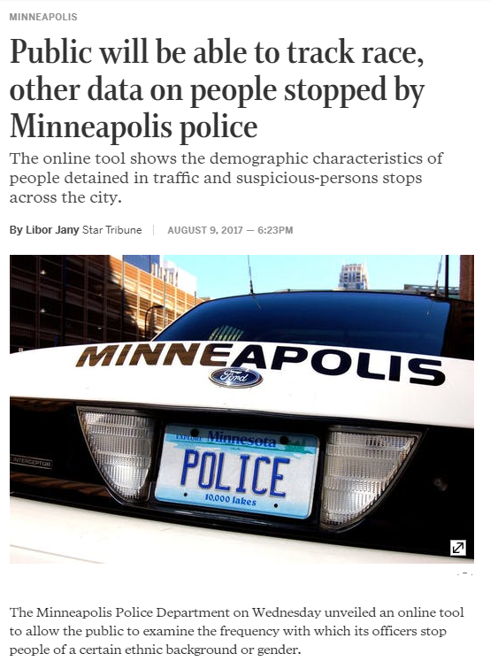
Introduction

Slide 3
Datasets
Minneapolis Police Traffic Stop Data, 2016-Current
http://opendata.minneapolismn.gov
Census Tract Geographies for Hennepin County
Household Demographics on HoH Race and Median Income by HoH Race
Minneapolis Neighborhood Geographies (aka ‘Communities’)

Slide 4
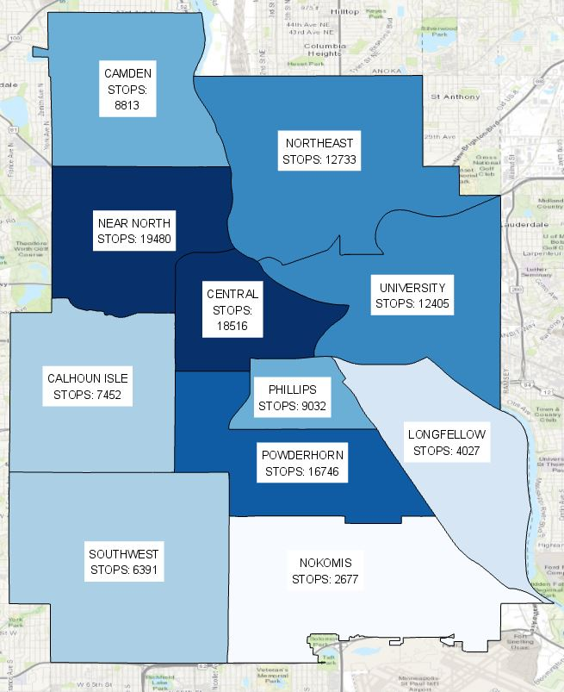

Methods
Loading CSV data and shapefiles (with the help of shp2pgsql) via command line
Querying the data in my database to explore it
Coming up with relevant questions based on data exploration
Visualizing via QGIS/ArcPro
CREATE VIEW neighborhoods_stops_count
AS SELECT count(stops.gid) as stop_count, n.commname as neighborhood, n.geom
FROM minneapolispolicestops as stops
INNER JOIN neighborhoods as n ON ST_Intersects(stops.geom, n.geom)
GROUP BY n.commname, n.geom

Slide 5
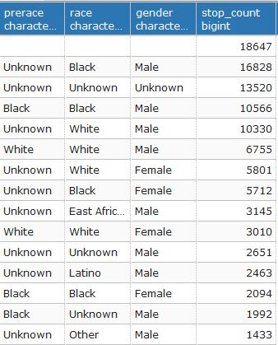
Who is being stopped by police?
SELECT prerace, race, gender, count(gid) as stop_count
FROM minneapolispolicestops
GROUP BY prerace, race, gender
ORDER BY stop_count DESC LIMIT 15;
What is the role of Unknown and Null values?

Slide 6
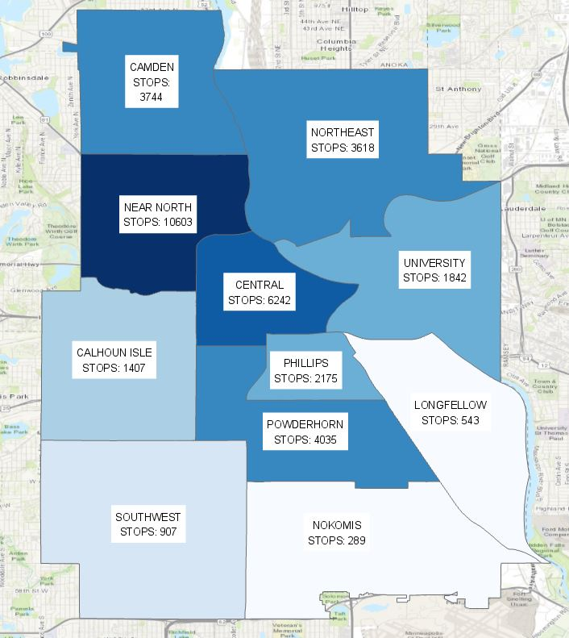
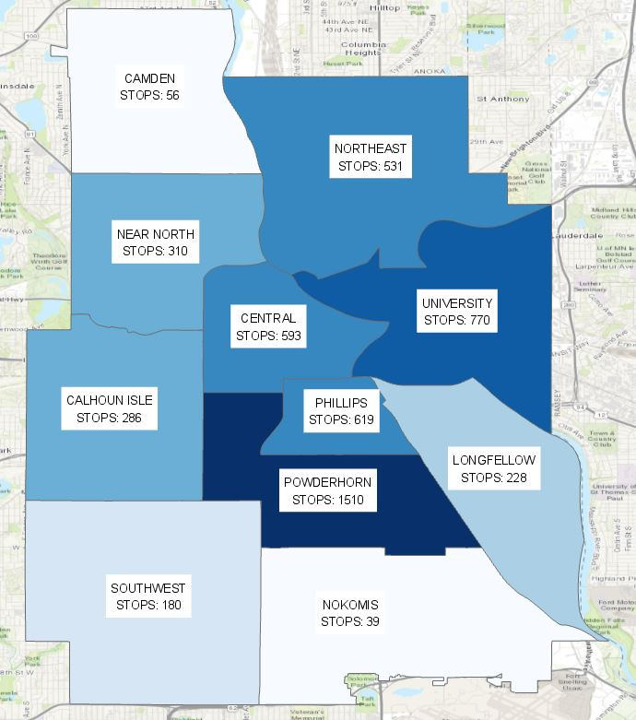
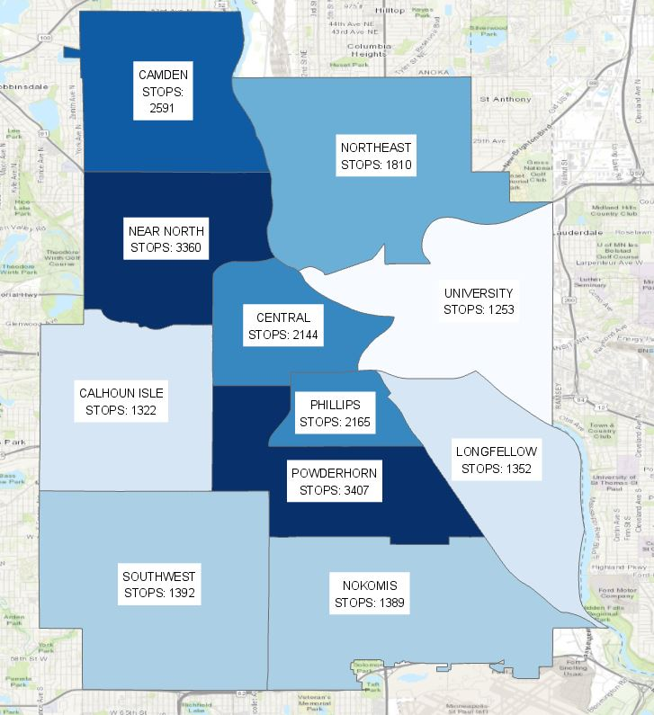
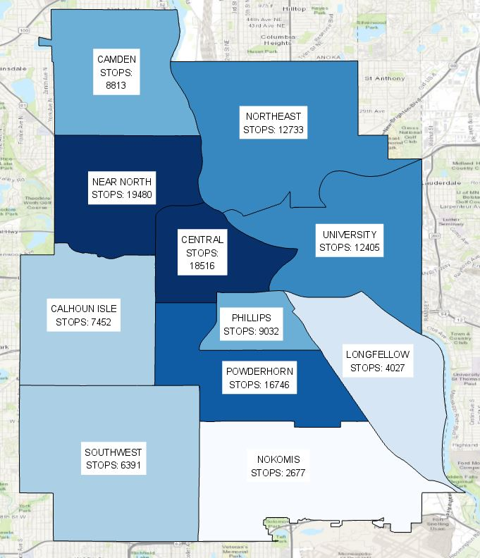
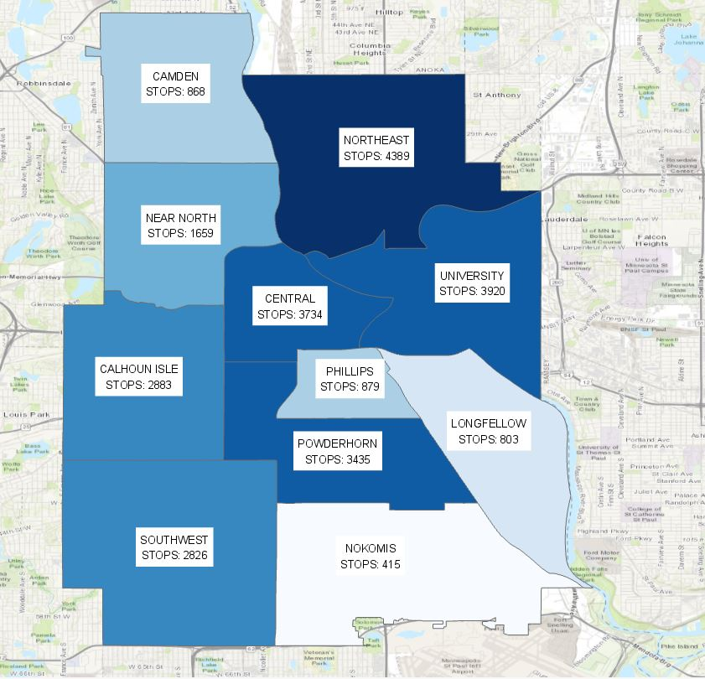
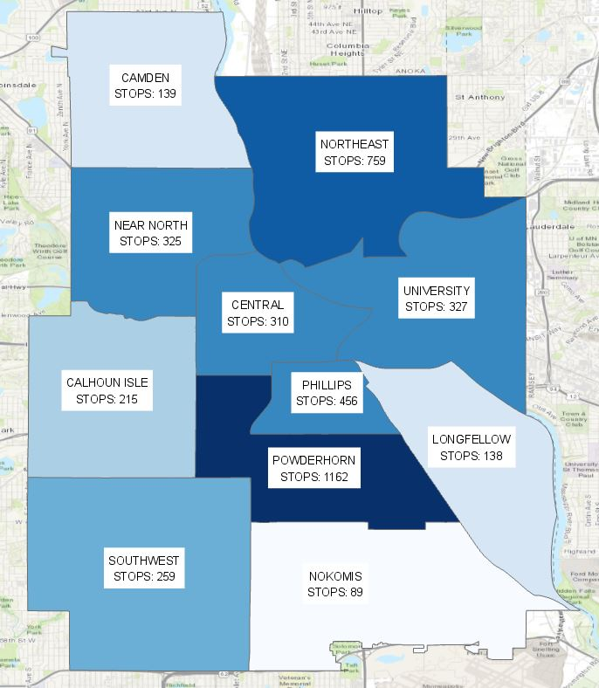
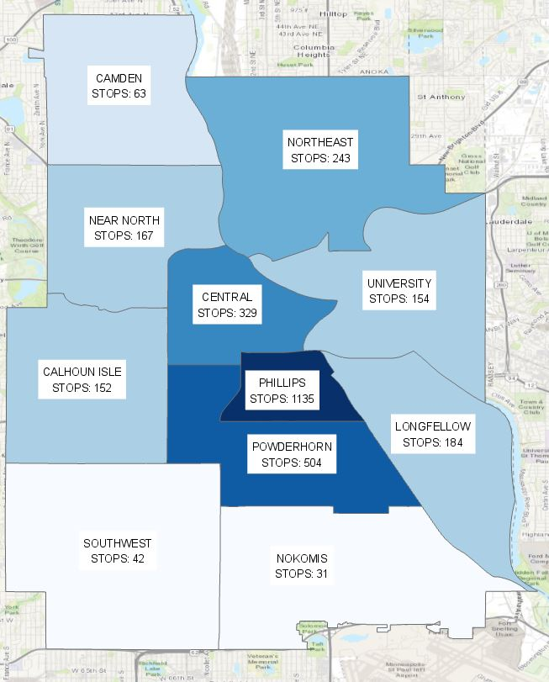
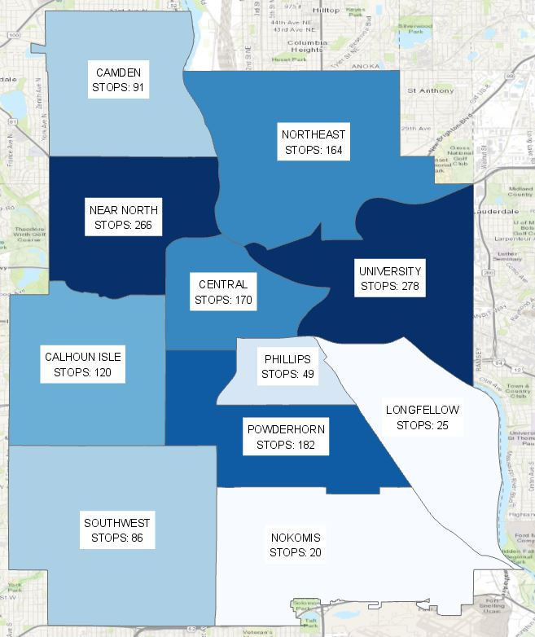
Stops by Race: Black
Stops by Race: East African
Race = Unknown
Race = NULL
Stops by Race: White
Stops by Race: Latinx
Stops by Race: Native
Stops by Race: Asian

Slide 7
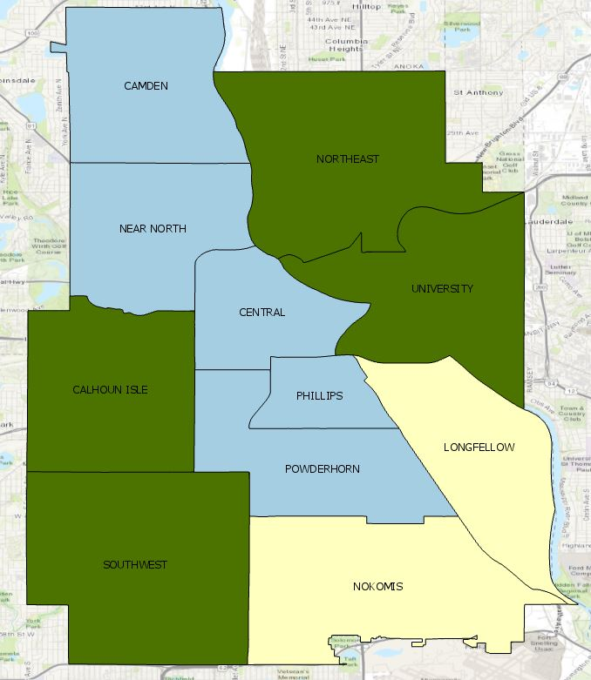

CREATE VIEW mostcommonracestopped_neighborhoods AS
SELECT DISTINCT ON (commname) commname, most_frequent_value,geom
FROM (
SELECT n.commname, s.race AS most_frequent_value, count(*) AS _count, n.geom AS geom
FROM minneapolispolicestops AS s
INNER JOIN neighborhoods AS n ON ST_Intersects(s.geom, n.geom)
GROUP BY n.commname, s.race,n.geom) a
ORDER BY commname, _count DESC

Slide 8
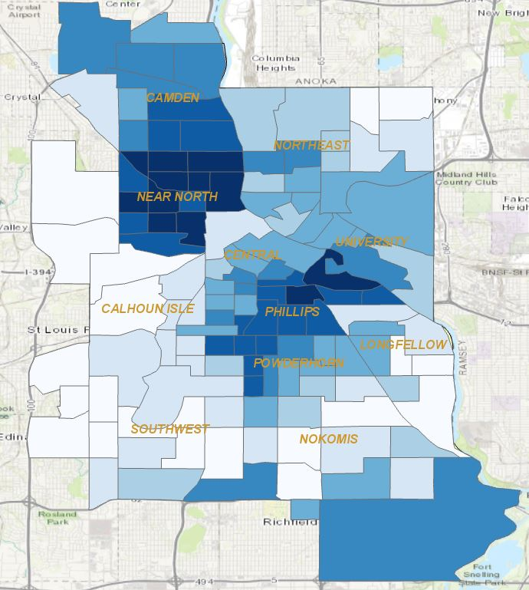
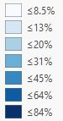

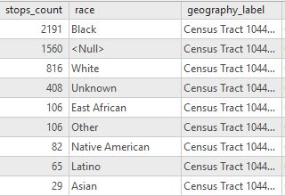
Household Demographics & Police Stops
Nonwhite Households/ Total Households
76% of police stops are POC in tract 1044 (excludes null & unknown race)
21% of households in tract 1044 are non-white Heads of Households

Slide 9
Challenges
Loading Police Stops data
Using SHP2PGSQL (without checking the create statement) vs. using my own create statements meant foreign keys would be different data types between tables
Solutions
Left computer plugged in at night, turned off auto-sleep/shut down option
Became comfortable casing data types

Slide 10
Conclusions
Unknown and Null values seem important to look at further to understand the bias behind police stops and the bias behind the officers who input this data.
As we all knew, police stops are racist because our policing system is racist!

Slide 11
Questions?

